Slide 1
Ectodomain Shedding in Neurodevelopment
Simon Hua

Slide 2
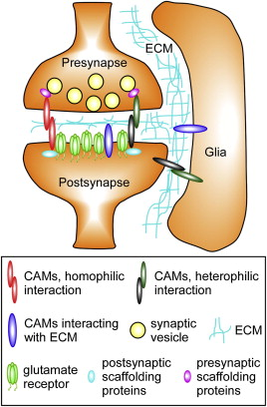
Introduction
Notes:
Proper synaptic plasticity is necessary for functional connectivity of the nervous system
Aberrant synapse formation leads to numerous neurodevelopmental and neurodegenerative disorders, such as Down syndrome and Alzheimer’s disease, respectively
Various cell adhesion molecules, including neuroligin, neurexin, ephrin, and Eph receptor mediate synaptic plasticity throughout neurodevelopment

Slide 3
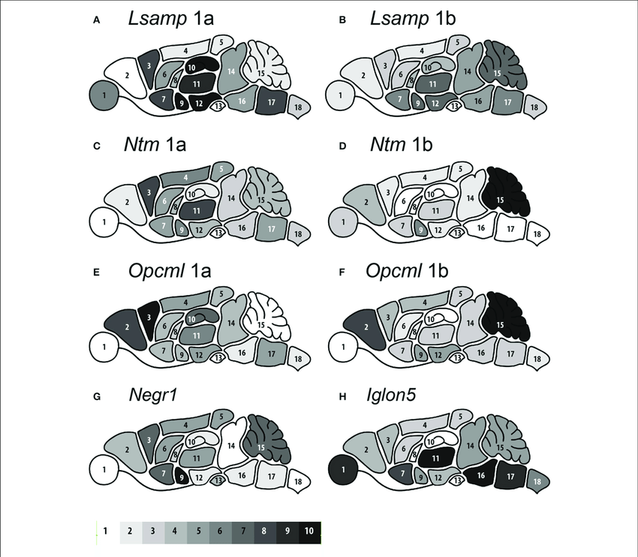
Rationale
Notes:
IgLON proteins of immunoglobulin superfamily have been demonstrated as important regulators of cell adhesion, subdomain target recognition, and neurite outgrowth
Implication of IgLON proteins in synaptogenesis has been suggested in literature
IgLONs co-localize with synaptic markers, such as vesicle-associated membrane protein 2, and play a role in neurological disorders, such as autism spectrum disorder

Slide 4
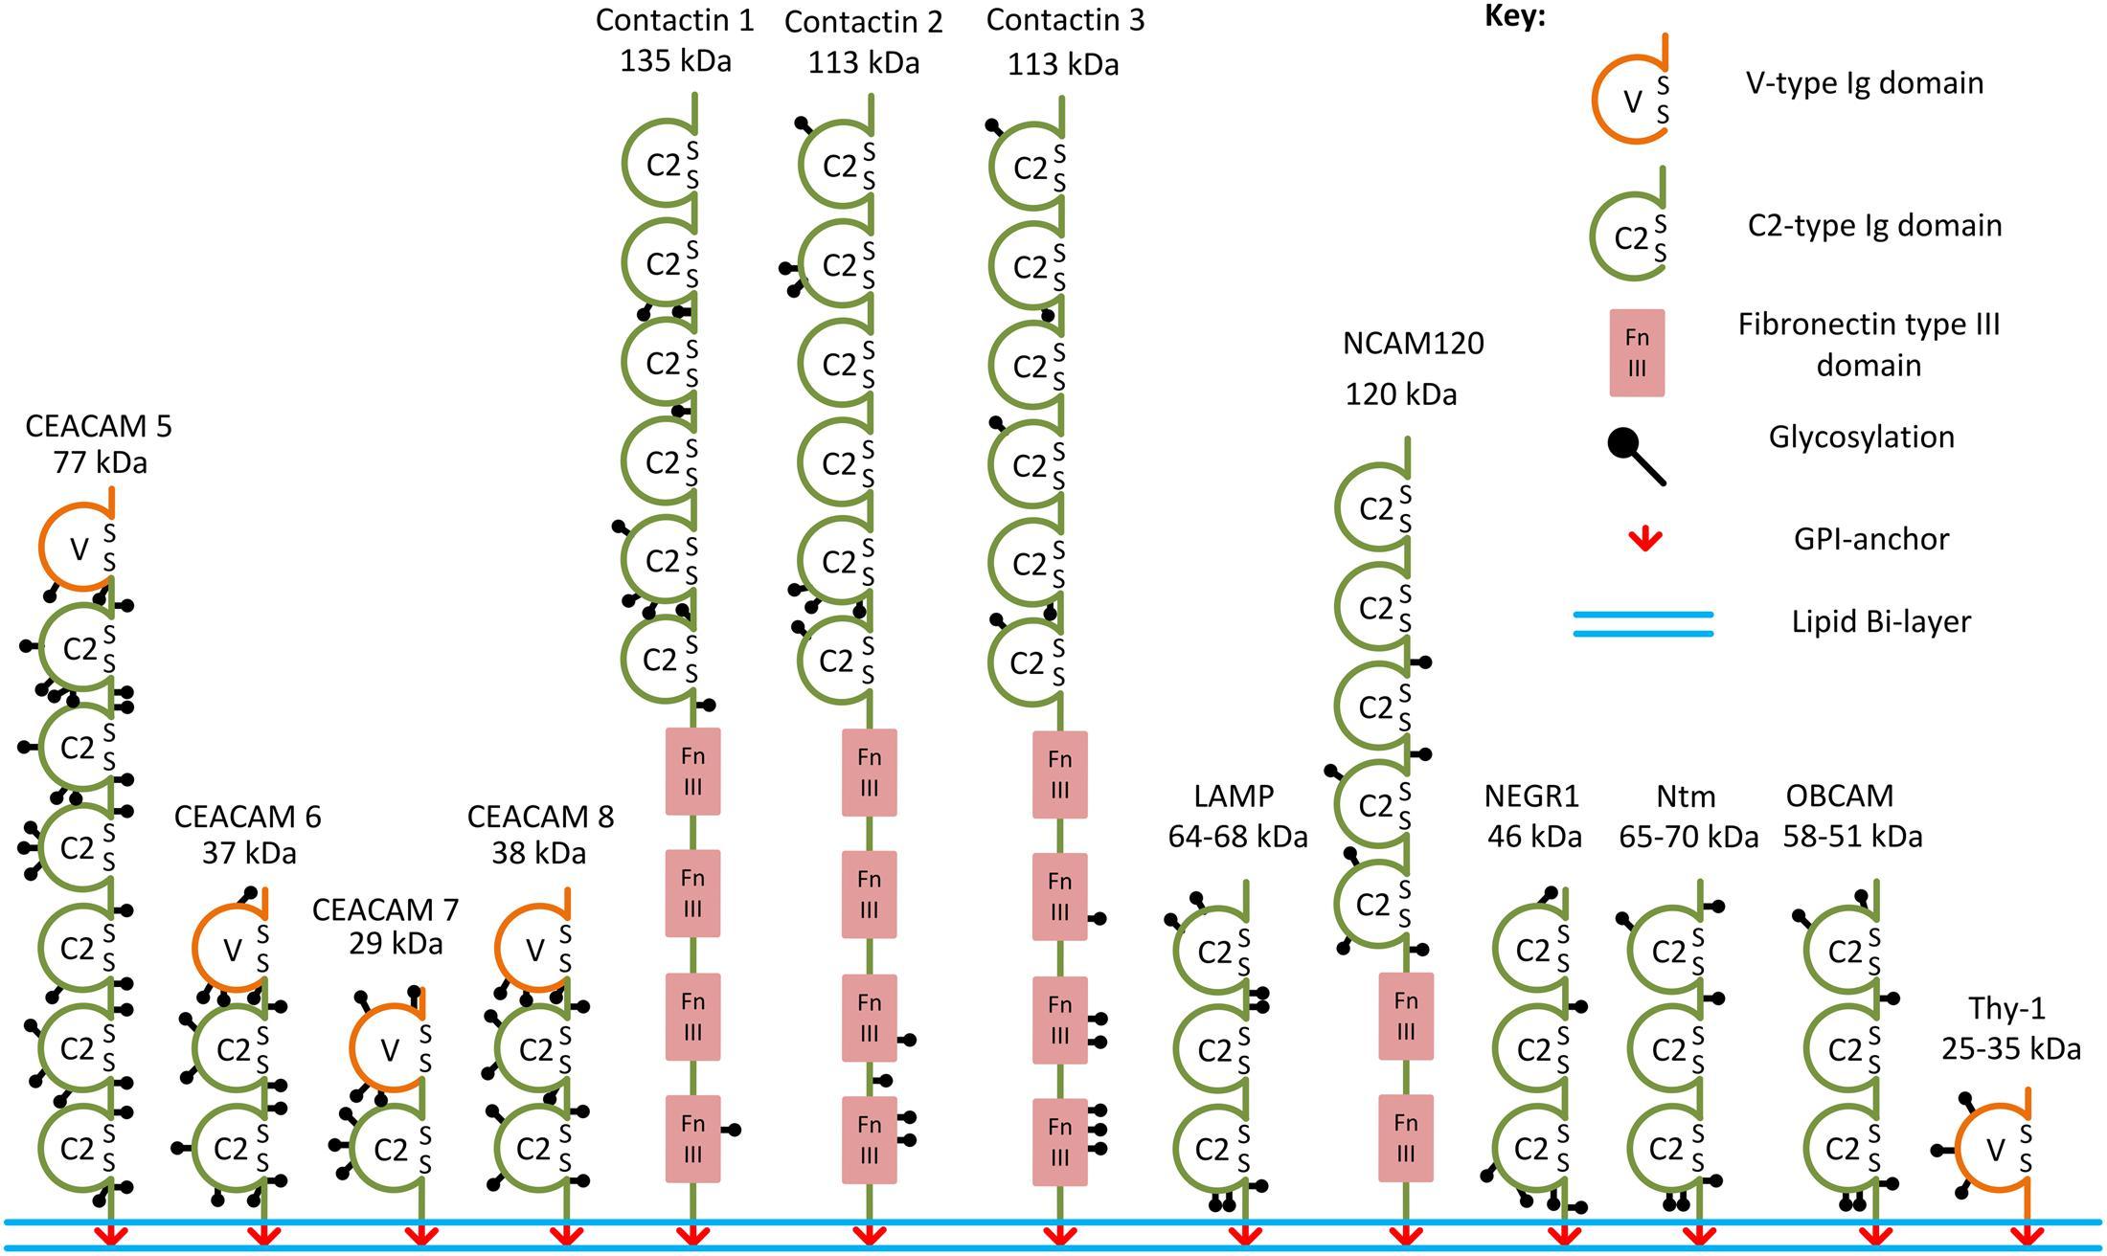
Objective
Notes:
Determine role of IgLONs in synaptogenesis

Slide 5
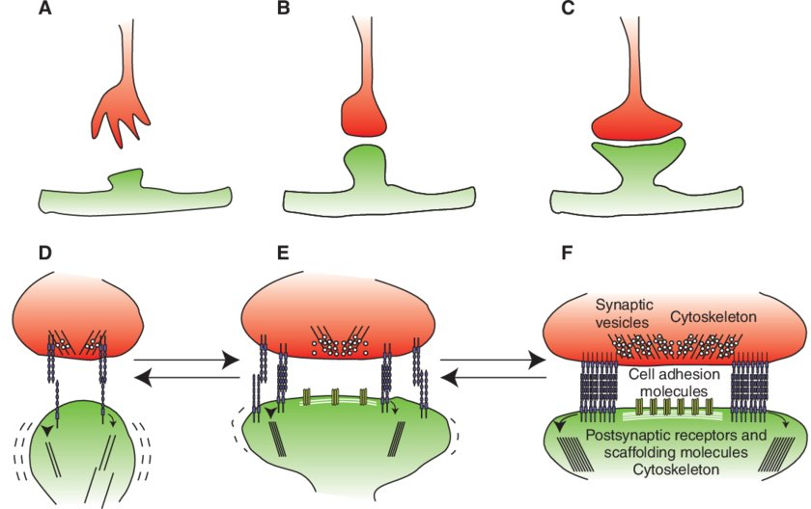
Hypothesis
Notes:
IgLONs play a role in synapse formation and plasticity

Slide 6
Method and Analysis
In utero electroporation with control or IgLON expression vector
Perfusion
Cryosection
Spinning disk microscopy
Analysis of dendritic spine density as quantification of synaptogenesis

Slide 7
Challenge
Proper analysis of dendritic spines requires a program to visualize the images
Assess Imaris and Fiji for this purpose

Slide 8
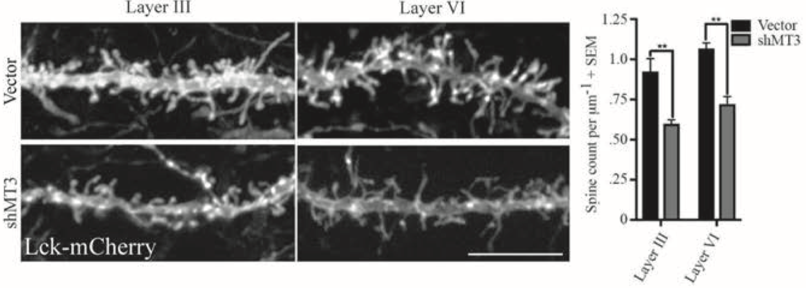
MT3-MMP promotes excitatory synapse formation by promoting Nogo-66 receptor ectodomain shedding

Slide 9
Fiji
Control
shMT3

Slide 10
Fiji

Slide 11
Imaris
Control
shMT3

Slide 12
Imaris
*

Slide 13
Conclusion
2D images from Fiji exclude spines that overlap or protrude in and out of 2D plane
Analyzing using Fiji plane by plane reduces contrast between signal and noise
Length of dendrite is decreased when file is projected onto 2D plane using Fiji
Notes:
Neuron in Fiji is a 2D image constructed by projection of the original stick figure file onto a single plane
Neuron in Imaris is a 3D image reconstruction of the original stick figure file
Spines were manually selected for both the analysis performed using Fiji and Imaris
Difference between the two quantifications was due to how the images were constructed and interpreted

